Slide 1
Duality in Convex Optimization
Elizabeth Graham
Tyson Lipscomb
David Sullivan

Slide 2

Concepts of Duality
Reflexive dual
Mirror image
Dual perspectives on one reality
Wave/particle duality
Mind/body duality
Complimentary duality
Yin and yang
Good and evil

Slide 3

Duality in Mathematics
Most duals in Mathematics are reflexive (mirror images)
Dual of the dual = original
Considered a “natural transformation” in category theory
Duality in Optimization generally offers a dual perspective
Reflexive:
Linear programming dual
Not reflexive: (inference or relaxation duality)
Surrogate dual
Lagrangian dual (relaxation duality)
Superadditive dual

Slide 4
Relaxation Duality
Relaxation duality is a duality of restriction and relaxation.
The original problem (or primal function) can be solved by enumerating restrictions.
The dual can be solved by enumerating parameterized relaxations.
3 benefits of duals:
It reveals connections that might not otherwise be noticed.
It can unify solution methods.
It can suggest new solution methods.

Slide 5
Motivation
Simplifies the optimization of an inequality-constrained problem
The dual problem is often easier to solve because
The addition of the λ and ν vectors add more constraints
Limits the scope of the original (primal) problem
The dual function will always be concave, even if the primal problem is not convex.

Slide 6
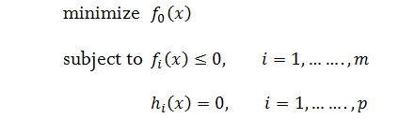


Linear Approximation Interpretation
Consider a standard optimization problem:
Rewriting this as allows us to remove the constraints f_{i} or h_{i} values if they are not within the constraints by setting

Slide 7
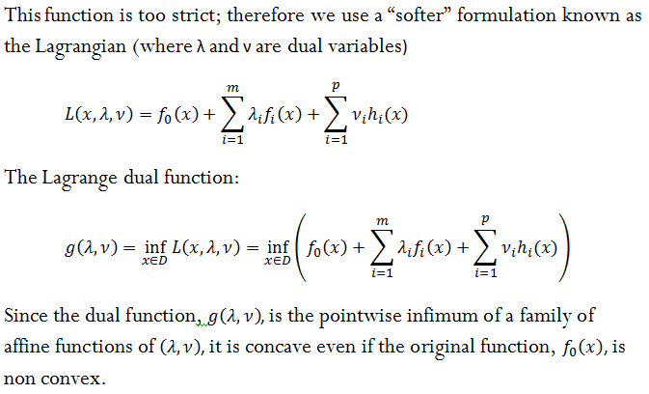
The Lagrange Dual Function
This function is too strict; therefore we use a “softer” formulation known as the Lagrangian (where λ and ν are dual variables)
The Lagrange dual function:
Since the dual function, g(λ,ν) ,is the pointwise infimum of a family of affine functions of (λ,ν),it is concave even if the original function, f₀, is not convex.
Notes:
lamda for the inequality constraints and nu for the equality constraints

Slide 8
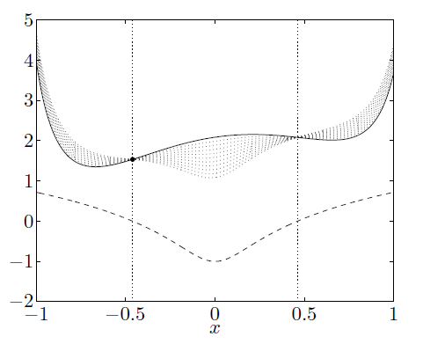
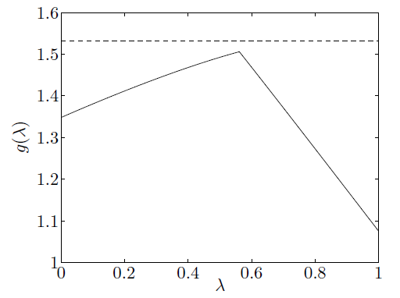
Figure 1. The lower bound from a dual feasible point
Figure 2. The dual function, g(λ,ν), for the problem in Figure 1.
The solid curve shows f₀ and the dashed curve shows the constraint, f_{i} over the feasible set [−0.46, 0.46], (indicated by the dotted vertical lines). The optimal point and value shown as a dot. The dotted curves show L(x, λ) for λ= -0.1, 0.2,…,1.0. Each of these has a minimum value smaller than f₀(x*), since on the feasible set (and for we have ).
Neither the original function, f₀, nor the constraint, f_{i}, is convex, but the dual function, g(λ,ν), is concave. The horizontal dashed line shows f(x*), the optimal value of the problem. The solid line shows the dual function.

Slide 9



LP Example Consider an LP in standard form:
Introducing λ_{i} and ν_{i} we can form the Lagrangian:
With this Lagrangian we can derive the dual to be:
Since -b^{T} ν is a constant, and the Lagrangian will only have a lower bound when we get the following constraints:

Slide 10
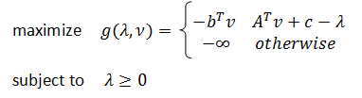
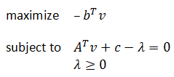

Lagrange Dual Problem
g(λ,ν) gives us a set of lower bounds, therefore we must maximize g(λ,ν) to determine the optimal (highest) value (d*).
Maximize g(λ,ν) with the constraint .
Re-visiting the LP example, we can re-write the maximization problem as:
Alternatively we can make the constraints explicit and re-write the problem as:
And then further simplify it as follows:

Slide 11
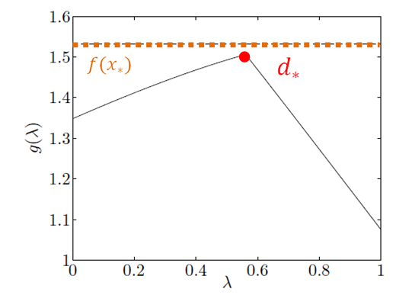
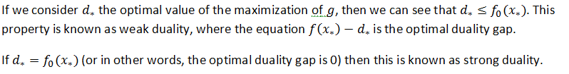
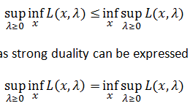
Strong and Weak Duality
,
Optimal value, d*
d* = max(g)
Optimality gap
Weak Duality
Strong Duality
Optimality gap = 0
Figure 3. An illustration of d*, f(x*), and the optimal duality gap

Slide 12
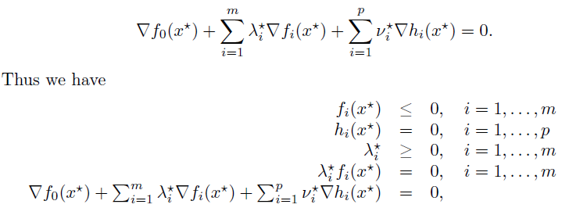
Karush-Kuhn-Tucker (KKT)
For any optimization problem with
differentiable objective (f₀) and constraint functions (h_{i})
for which strong duality applies ( )
any pair of primal and dual optimal points must satisfy KKT conditions
KKT conditions: (where x* and (λ*,ν*) are optimal points for the primal and dual functions and x* minimizes L(x, λ*,ν*))
Therefore:
Notes:
And vice versa…so if the conditions are met, then x, lambda, and nu are primal and dual optimal points
Proof is in the book

Slide 13
KKT applications
The KKT conditions play an important role in optimization.
In a few special cases it is possible to solve the KKT conditions (and therefore, the optimization problem) analytically.
Many algorithms for convex optimization are conceived as, or can be interpreted as, methods for solving the KKT conditions.

Slide 14



Example 5.1 Equality constrained convex quadratic minimization
Consider the problem:
where . The KKT conditions for this problem are:
which we can write as:
Solving this set of m+n equations in the m+n variables x*, ν* yields the optimal primal and dual variables

Slide 15
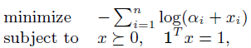
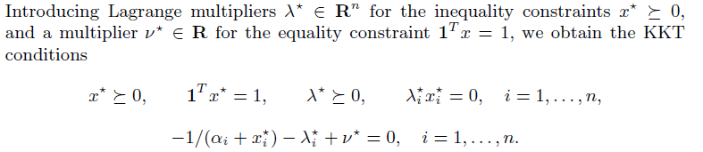


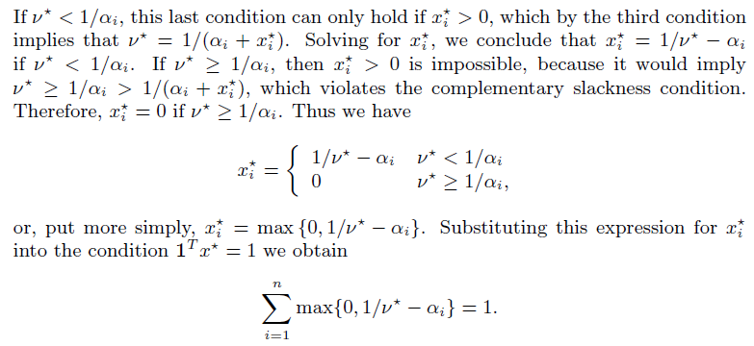
Example 5.2 Consider the following convex problem:
Introducing Lagrange multipliers we get the KKT conditions
In solving these for x* , λ*, and ν* we can eliminate λ* since it acts as a slack variable leaving:
The last condition can only hold if which, in conjunction with the third condition, implies that
Notes:
Alpha(i) > 0

Slide 16

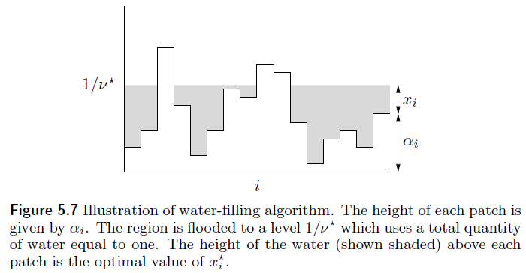
Therefore we get:
or
Substituting this for x* into the second condition ( ) we get:

Slide 17
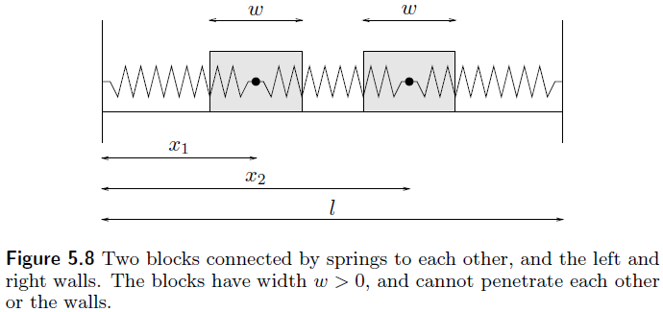

Mechanics Interpretation of KKT conditions
Consider the following figure:
The potential energy of the springs is:
Subject to the inequality constraints:
k₁
k₂
k₃

Slide 18
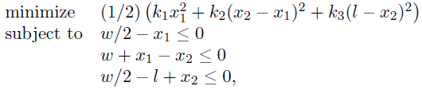
The equilibrium position will therefore be the optimization of the following QP problem:
Using the Lagrange multipliers: λ₁ λ₂ λ₃ (that can be thought of as contact forces between the walls and blocks), the kinematic and nonnegativity constraints as well as the complimentary slackness and zero gradient condition, the previous constraints are modified to form the following KKT conditions:
Notes:
If the solution to the optimization of the Lagrangian is primal feasible (i.e. the point is contained in the primal domain) then it is the primal optimal point as well. If it is not primal feasible (within the primal domain) then we can conclude that no primal optimal point exists.

Slide 19
In Conclusion
Lagrangian duals can be used to potentially simplify complex optimization problems
The addition of Lagrangian multipliers, λ and ν, can allow the problem to potentially be solved analytically
These modifications allow convex optimization algorithms to be applied that otherwise may not have been eligible

Slide 20
References
Stephen Boyd and Lieven Vandenberghe. Convex Optimization. Cambridge University Press, 2004.
Haitham Hindi. “A Tutorial on Convex Optimization II: Duality and interior Point Methods” In Proceedings of American Control Conference, 2006.
J. N. Hooker “Duality in Optimization and Constraint Satisfaction” Carnegie Mellon Univ. Pittsburgh, USA, September 2006.

